Slide 1
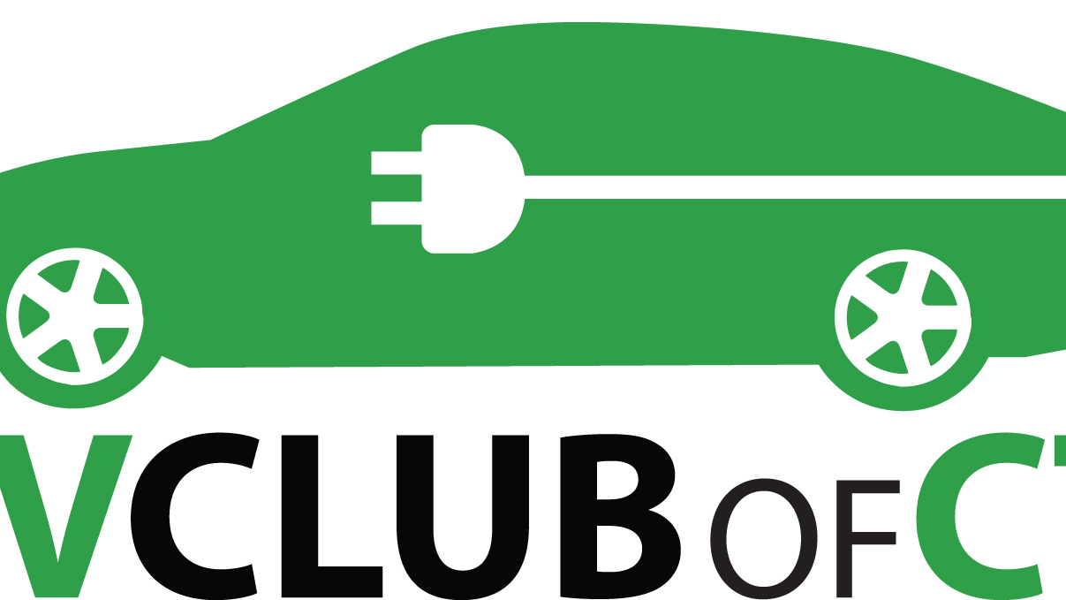
Environmental Summit
Barry Kresch, President

Slide 2
Transportation Accounts for 38% of Emissions in CT
Source: DEEP
Notes:
With almost 40% of emissions coming from the transportation sector, any climate scientist will tell you that EVs (and electrification of transportation, generally) are an important part of the solution.

Slide 3
Benefits of Direct Sales
Pro Consumer
Accelerate EV Adoption
Support Innovation and Free Market
Investment and Jobs
How CT Positions Itself

Slide 4
Background: Franchise Laws/ Proposed Legislation
State law from the 1930’s – 1950’s intended to protect dealerships from their own affiliated manufacturers.
New vehicles have to be sold by independent businesses.
It wasn’t about the consumer. It still isn’t.
Proposed direct sales legislation applies to EV exclusive manufacturers without a franchisee network only. It does not remove existing dealer protections.

Slide 5
EV Freedom Bill Enable all aspects of the sales process.
Sales/Leasing
Test Drives
Delivery
Service

Slide 6
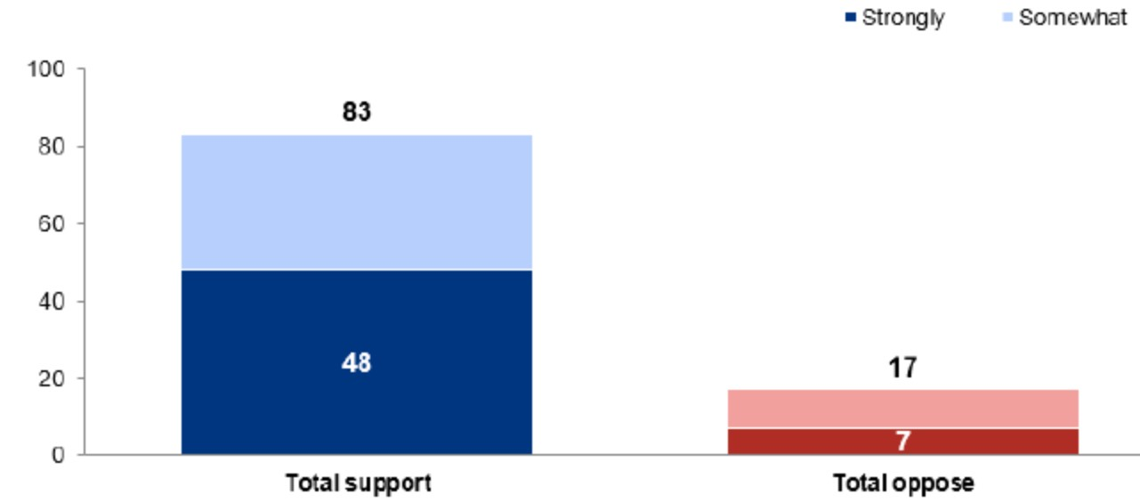
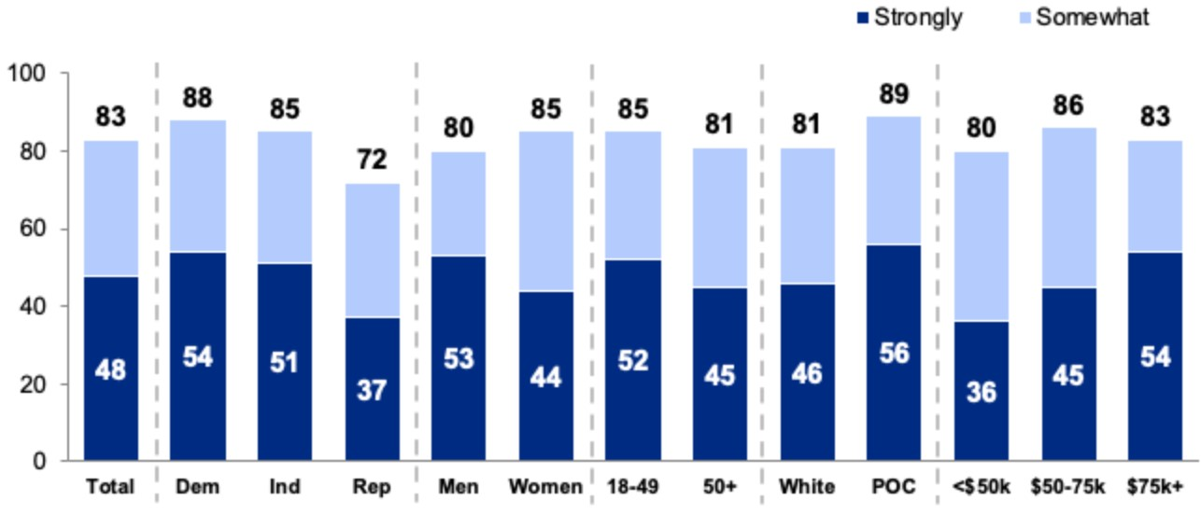
Pro Consumer
83% Support (Poll of Registered Voters, April 2021)
Public Testimony – A shutout (69-0 in favor)

Slide 7
EV Adoption – A Long Way to Go

Slide 8
Open vs Closed States – It Makes A Difference
www.bloomberg.com/opinion/articles/2022-01-05/car-dealership-laws-aren-t-fit-for-the-ev-age
BEV registrations per 1,000 registrations, 2020

Slide 9
Numerous Organizations Have Editorialized
Federal Trade Commission: “Our point: States should allow consumers to choose not only the cars they buy, but also how they buy them.” Link
Bloomberg: The point here isn’t that dealerships must be eviscerated, but only that they shouldn’t enjoy protected status hindering new entrants.
Union of Concerned Scientists: …the arguments raised in support of banning direct manufacturer sales are poor…most independent economists believe that dealer franchise laws impose costs on consumers to the benefit of dealers. 2 Posts about CT here and here.

Slide 10
Additional Links
Consumers facing dealer markups over MSRP. Torque News
EV Club CT makes the case for direct sales.
National Consumer Law Center: Racial Disparities in Auto Loan Markups.
The Simplest Way to Sell More Electric Cars in America – Atlantic Magazine
Electric Vehicle Club of Connecticut – EVClubCT.com

